Slide 1
MOBILE MANUFACTURING – ANALYSIS USING SQL
DATA SOURCE - KAGGLE
PRESENTED BY: ABHISHEK SUNEJA

Slide 2
BUSINESS Scenario:
The database “Cellphones Information” contains details on
cell phone sales or transactions.
Details stored are: Dim_manufacturer, , Dim_model, Dim_customer, Dim_Location, Dim_date and Fact_Transactions.

Slide 3
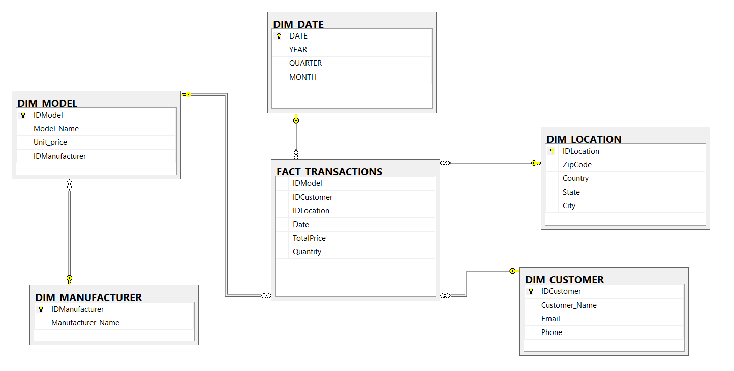
ER MODEL

Slide 4
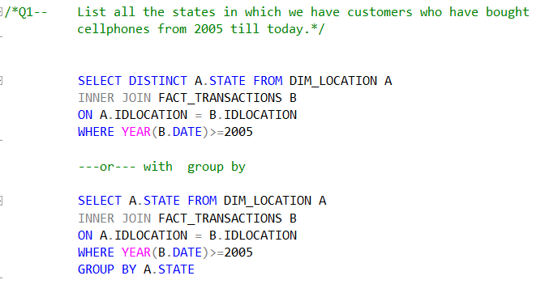
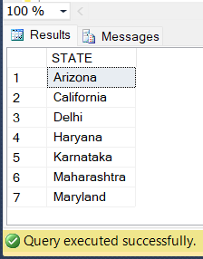
PROBLEM STATEMENT
SOLUTION
Q1 - List all the states in which we have customers who have
bought cellphones from 2005 till today.

Slide 5
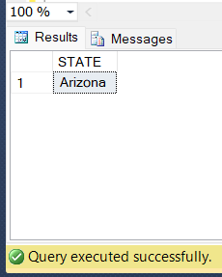
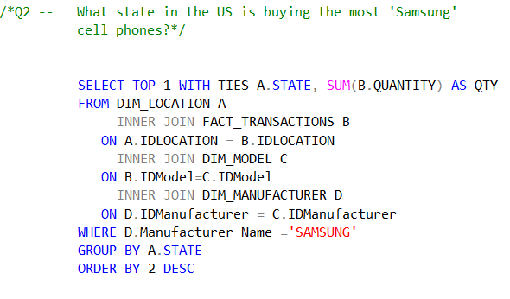
PROBLEM STATEMENT
SOLUTION
Q2 - What state in the US is buying the most 'Samsung'
brand cell phones?

Slide 6
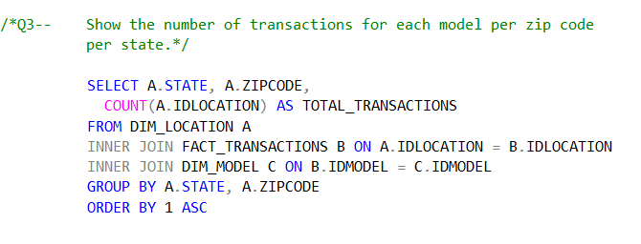
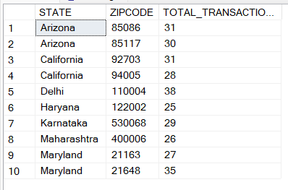
PROBLEM STATEMENT
SOLUTION
Q3 - Show the number of transactions for each model per zip code per state.

Slide 7
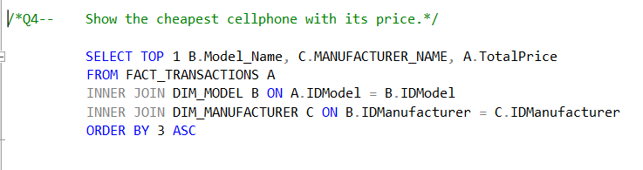
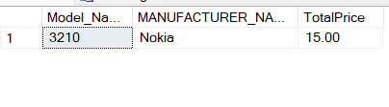
PROBLEM STATEMENT
SOLUTION
Q4 - Show the cheapest cellphone with its price.

Slide 8
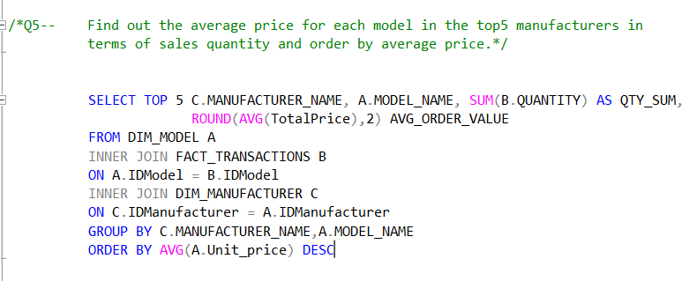
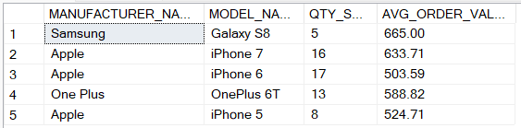
PROBLEM STATEMENT
Q5 - Find out the average price for each model in the top5 manufacturers in terms of sales quantity and order by average price.
SOLUTION

Slide 9
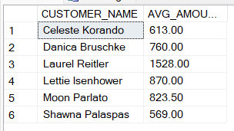
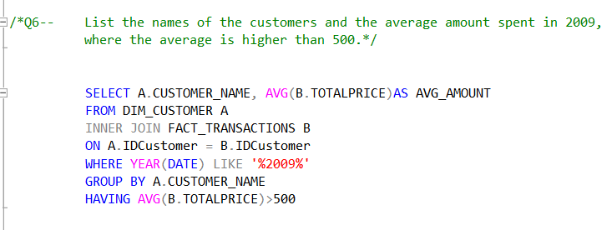
PROBLEM STATEMENT
SOLUTION
Q6 - List the names of the customers and the average
amount spent in 2009, where the average is higher than 500.

Slide 10

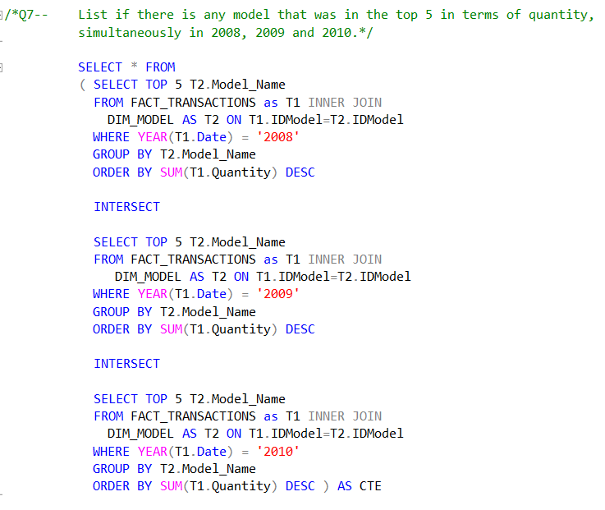
PROBLEM STATEMENT
SOLUTION
Q7 -List if there is any model that was in the top 5 in terms of quantity, simultaneously in 2008, 2009 and 2010.

Slide 11

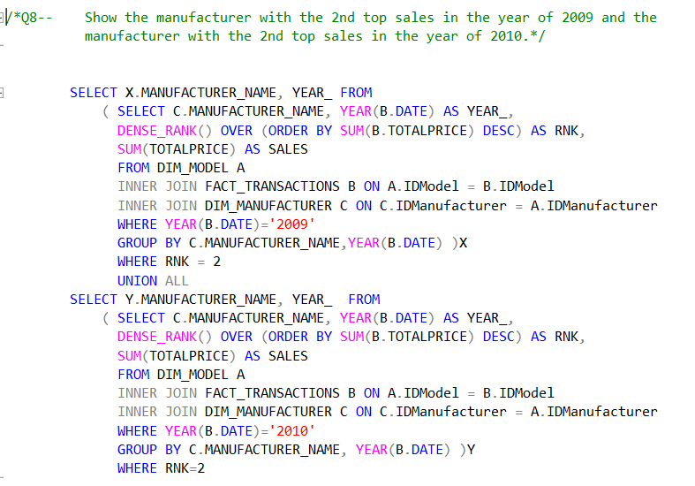
PROBLEM STATEMENT
SOLUTION
Q8 -Show the manufacturer with the 2nd top sales in the year of 2009 and the manufacturer with the 2nd top sales in the year of 2010.

Slide 12

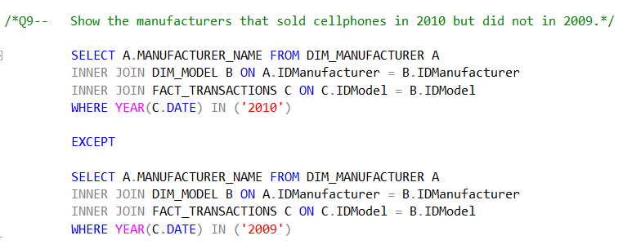
PROBLEM STATEMENT
SOLUTION
Q9 -Show the manufacturers that sold cellphones in 2010 but did not in 2009.

Slide 13
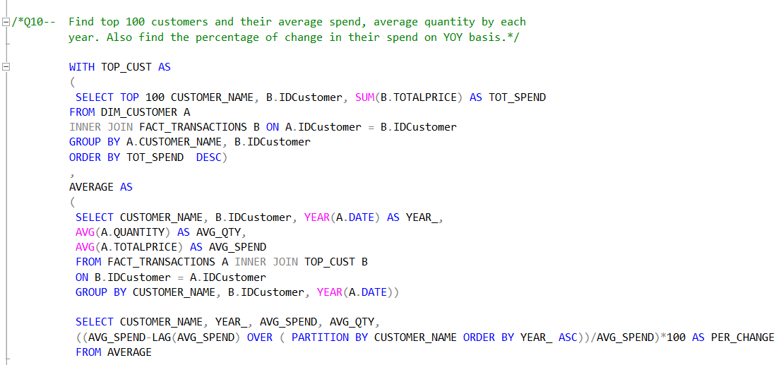
PROBLEM STATEMENT
Q10 - Find top 100 customers and their average spend, average quantity by each year. Also find the percentage of change in their spend on YOY basis.

